Slide 1
Project 1 - Team 4
Sadika Amreen
Christopher Daffron
David Mercer
Josh Willis

Slide 2

Project Description
Goal:
To discover potential markets and key features in Bitbucket public repository data
Approach:
Perform analysis on repository data extracted from BitBucket API

Slide 3
Methods
BitBucket Search
Only finds repositories related to search
HTML has extraneous data => network heavy => slow computation time
BitBucket API
Finds all public repositories
JSON has only data related to the repository
Amount of data is small compared to HTML

Slide 4
Extracted Repository Attributes
Name
Owner
Language
Size
Last updated date
Creation date
Type of version control

Slide 5
Developer Paradise Metrics
Number of public repositories
Number of users
Statistics of languages used
Most popularly used language
Percentage of active repos
Average size of the repos
Percentage of repos above 1 gig
Percentage of repos using Git as version control

Slide 6
Initial Metrics
Number of Repositories
414,406 public repositories
Active Repositories
43,349 updated within the last 30 days
10.5% of all public repositories
Total users found
188,874 unique usernames own repositories
BitBucket is known to have over 1,000,000 users as of 2013
http://techcrunch.com/2013/06/04/atlassian-bitbucket-passes-1-million-users-another-validation-of-the-fast-growing-developer-market/

Slide 7
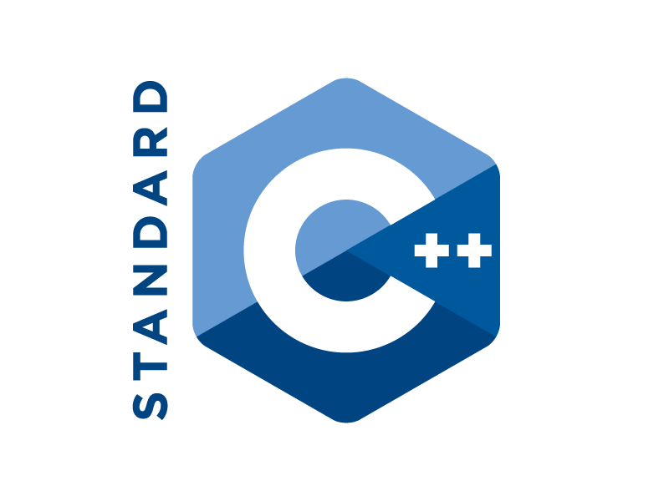

Analysis
Proportion of repositories for each language
Language | Count | Percent
Python | 44,460 | 11
Java | 39,408 | 10
PHP | 22,982 | 6
C++ | 20,629 | 5
C# | 18,663 | 5
Missing (Not Specified) | 169,745 | 41
Other | 98,514 | 22

Slide 8
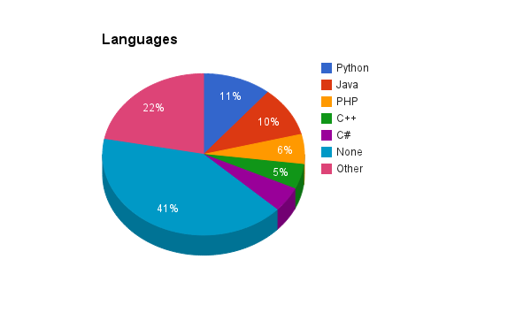

Slide 9


Analysis
Ratio of Git repositories to Mercurial repositories
Git is the most popular
250,090 repositories
Mercurial
164,296
Only 15 missing values

Slide 10
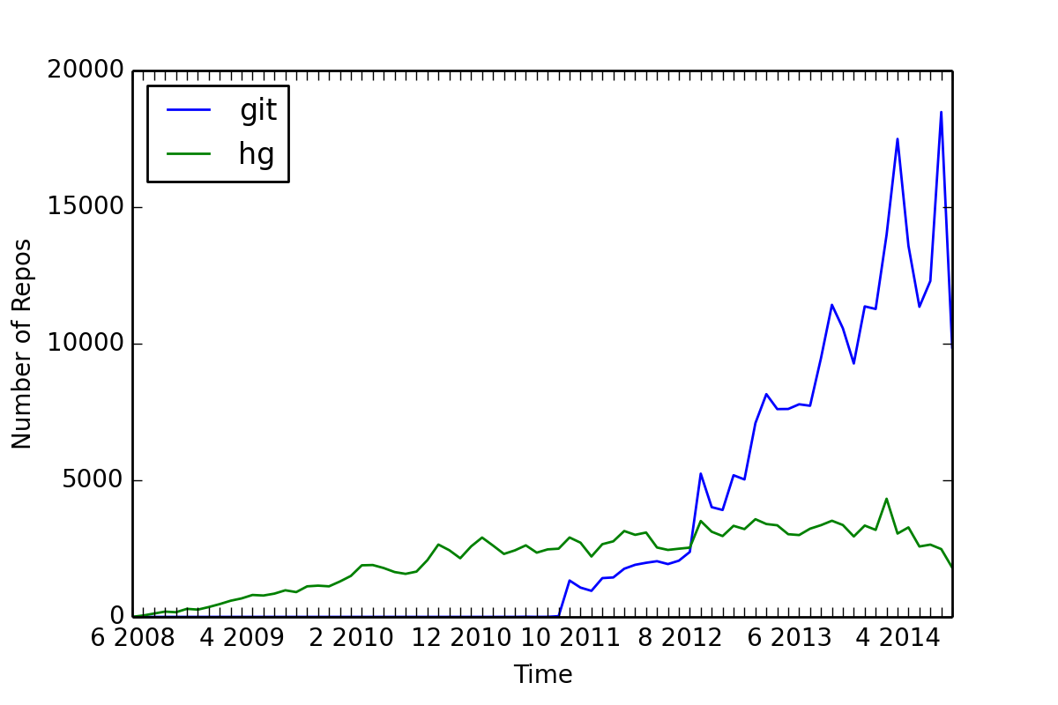
Repository Creation Over Time

Slide 11
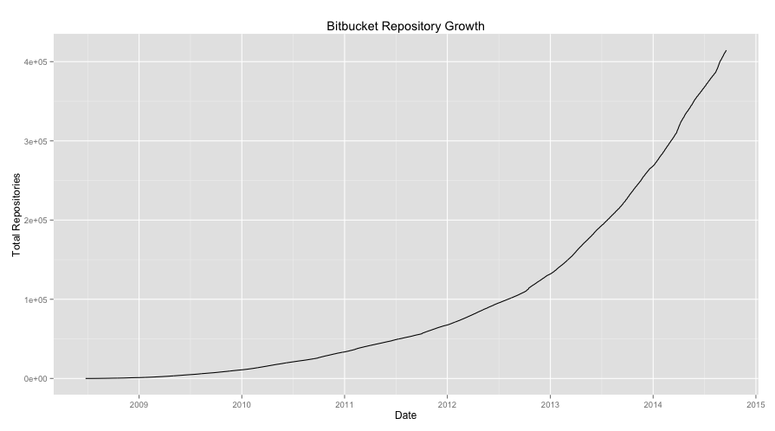
Public Repository Growth Rate

Slide 12
Analysis
Repository Size Statistics
Average size: 266 kB
Number of repositories larger than 1GB
11,138
2.7%
Most repos less than 2 MB - 75th percentile for size is at 2.25 MB

Slide 13
Missing Data
Repository Language
Not a mandatory field
Private Repositories
Not included in API calls
Public Repository Owners
Only users with a public repository are included in the list of users
Failed API calls
Links leading to error pages (ex. repositories not having any commits)

Slide 14
Challenges
Some fields have multiple entries
Extracting a csv results in multiple comma separated values for one field.
All characters were found to be permissible for use in the ‘name’ field - while extracting the data we could not delimit each field using characters such as ‘|’, ‘\’, ‘*’ etc.

Slide 15
Further Analysis
Recent Activity (commit frequency)
Most active language in the past month
Total Activity
Over the entire lifespan of the repository
Ratio of public to private repositories
How many private repositories are there?

Slide 16
Questions?

